Slide 1

MERN Stack Powered By Mongodb
E-Commerce Application Using MERN Stack
Ashrutha G
Nithin J
Sherine P
Mutheeswaran G
Michel Winsten Raj J

Slide 2
Problem Statement
In today's fast-moving digital economy, delivering a smooth and efficient online shopping experience is vital for both customers and businesses.
● Consumer Experience: Shoppers look for a user-friendly platform that simplifies product discovery, cart management, and the checkout process.
● Retailer Needs: Businesses seek a comprehensive solution to manage inventory, process orders, and engage with customers, driving operational efficiency and sales growth.
The goal of this project is to create a scalable, secure, and intuitive e-commerce platform that improves the user experience and streamlines backend operations.

Slide 3
Solution Proposed
User Interface Design: Craft an engaging and responsive front-end experience with React, ensuring intuitive navigation and an efficient purchasing process. State management will be handled by Redux Toolkit for smoother data flow.
Backend Development: Implement a RESTful API using Node.js and Express.js to handle data operations, manage user sessions with JWT, and facilitate secure transactions.
Data Storage and Management: Utilize MongoDB to store essential e-commerce data such as product catalogs, user profiles, orders, and inventory. Mongoose will streamline schema validation and query performance.
Performance and Security: Structure the platform to support future growth, ensure data safety with cors, and enable real-time notifications for order updates and system alerts.

Slide 4
Tech Stack
MongoDB: NoSQL database for storing patient, doctor, and appointment data.
Express.js: Backend framework for building RESTful APIs and handling server-side logic.
React: Frontend library for creating interactive and responsive user interfaces.
Node.js: JavaScript runtime environment for building scalable server-side applications.

Slide 5
Reason For Choosing These Technologies
MongoDB: Its flexible NoSQL schema makes it ideal for handling dynamic and scalable data like appointments and user profiles.
Express.js: Simplifies backend development with robust routing and middleware capabilities.
React: Provides a dynamic and interactive user interface with a component-based architecture.
Node.js: Offers a fast, scalable environment for building real-time, server-side applications.

Slide 6
In App Features
The e-commerce application provides essential features to enhance the shopping experience for users and streamline management for retailers. Key features include:
Sign Up: Allows new users to create an account, providing access to the full range of services.
Sign In: Enables returning users to log into their accounts securely.
Home Page: Showcases featured products, categories, and personalized recommendations for users.
Add to Cart: Users can easily add products to their shopping cart for future purchases.
Purchase: Facilitates seamless transactions, allowing users to complete their orders quickly and securely.

Slide 7
Benefits
Scalable Design: MongoDB's dynamic schema ensures the platform can adapt to increasing product listings, user registrations, and order volumes without performance degradation.
Flexible User Experience: React facilitates the creation of responsive, engaging interfaces that enhance user satisfaction and drive repeat visits.
Efficient Order Management: Real-time updates and notifications streamline order processing, reducing errors and improving delivery times.
Improved Customer Insights: MongoDB's data handling capabilities enable effective storage and analysis of customer behavior, supporting personalized marketing and product recommendations.

Slide 8
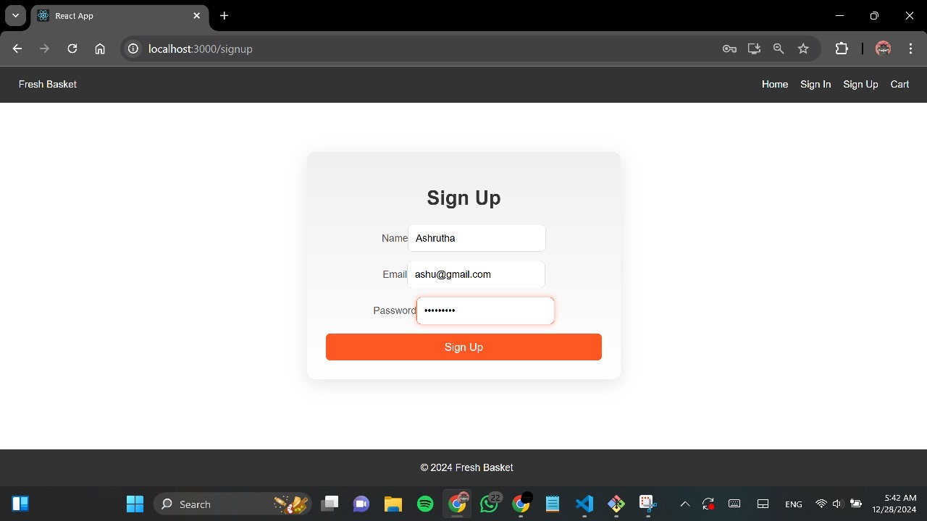
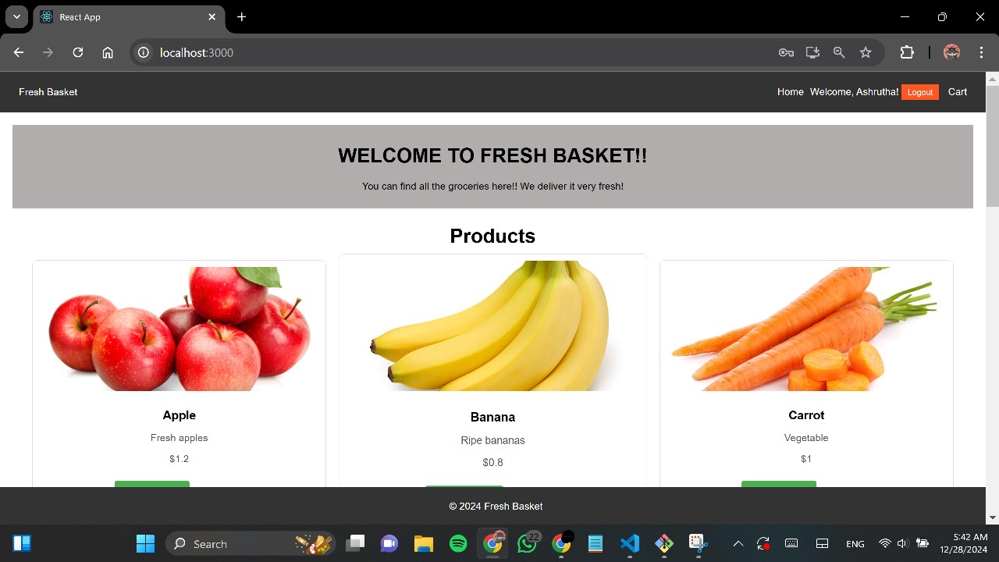
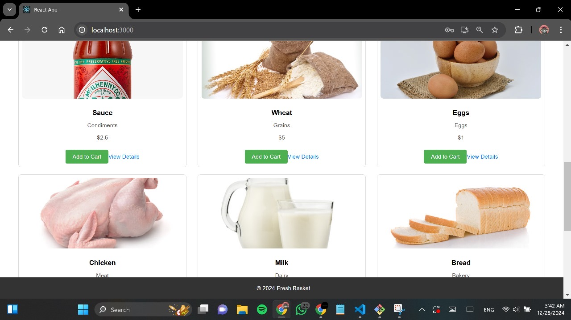
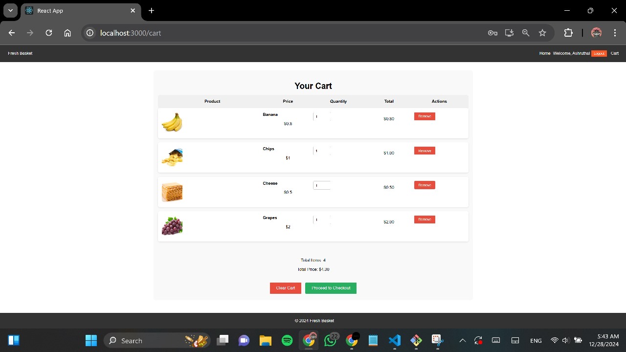
Screenshots

Slide 9
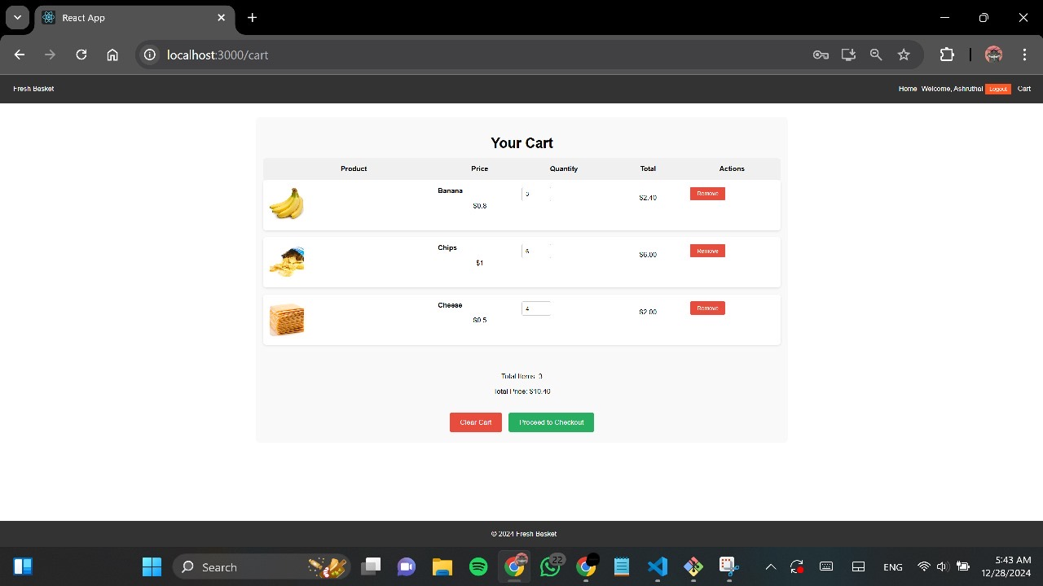
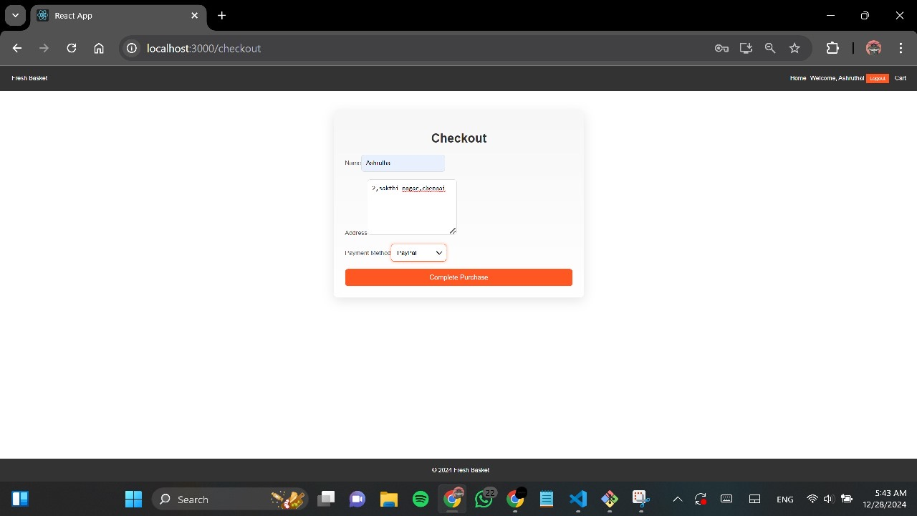
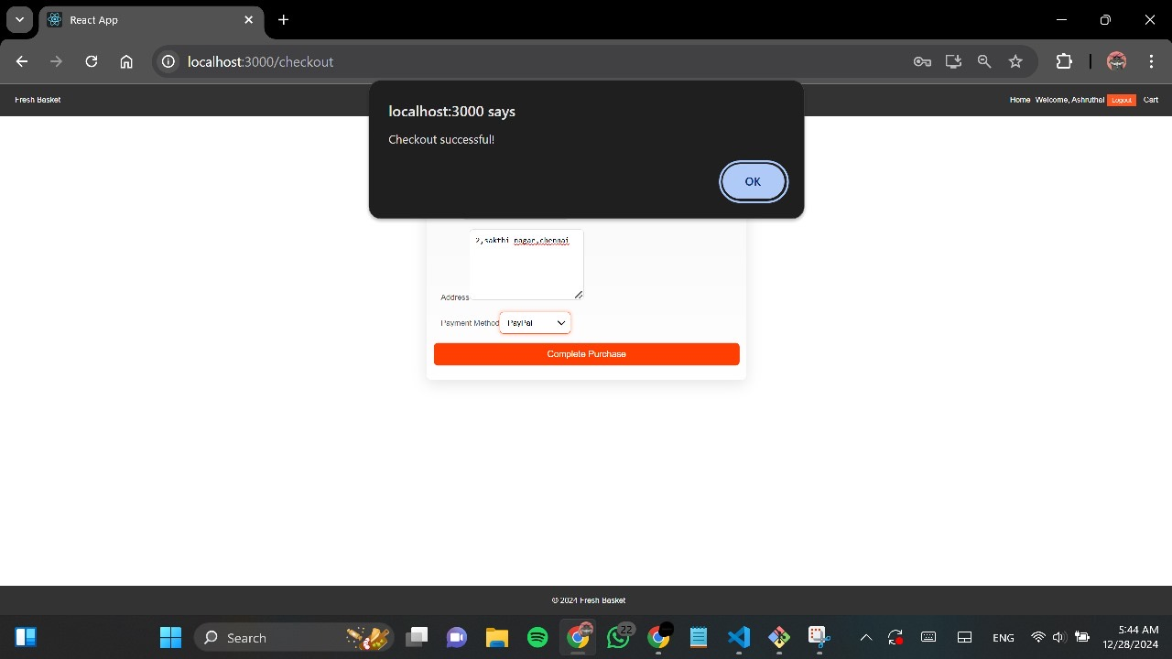

Slide 10
Thank You

